Slide 1



Airbnb Trends: Covid impact
Presented by Team 2
Amisha Turkel, Kamalika Das, Pushkar Shukla, Sanket Gupta, Shaanu Gupta

Slide 2


Agenda
Overview of Airbnb
Structuring the project
Descriptive Analysis of Data
Sentiment Analysis
Future Work

Slide 3
Airbnb, well known name in short term stay industry suffered due to impact of Covid-19 restrictions.
 | London | Austin
Population Density | 14,500/sq mi | 3,006.4/ sq mi
Covid Cases | 21.8 Million | 88.2 Thousand
Objective
How
Analyze the varying affect of pandemic on the Airbnb business of 2 cities of different sizes.
Comparative data analysis of pre and post covid years on specific metrics to determine the pattern and magnitude of change

Slide 4
Project Structure: Plan-based approach
Well defined plan of action that includes consideration of execution and control stages, resource management while also addressing the scope, cost and schedule baseline.
Set milestone activities:
INITIATING TASK
1
Familiarize with problem and project requirement draft
PLANNING TASK
2
WBS, resource and task estimation, task dependency
EXECUTING TASK
3
Data gathering and structuring, analysis and EDA
CLOSING TASK
4
Project report, build presentation

Slide 5
Resource Management
Define role, allocation of tasks, rate and % units performed
at resource level
PROJECT MANAGER | SENIOR CONSULTANT | ASSOCIATE CONSULTANT | DATA ANALYST | DATA ANALYST
Pushkar Shukla 50% $70/hr 4hrs/day | Kamalika Das 50% $60/hr 4hrs/day | Shaanu Gupta 50% $50/hr 4hrs/day . | Amisha Turkel 50% $40/hr 4hrs/day | Sanket Gupta 50% $40/hr 4hrs/day

Slide 6
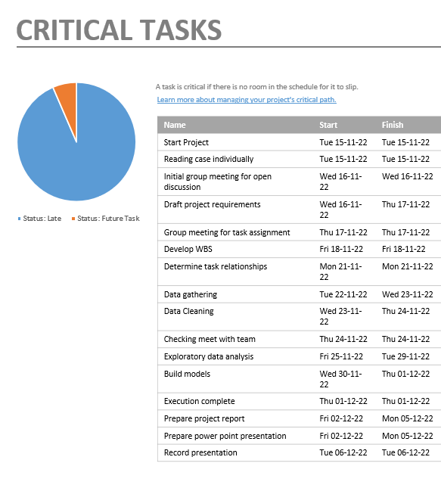
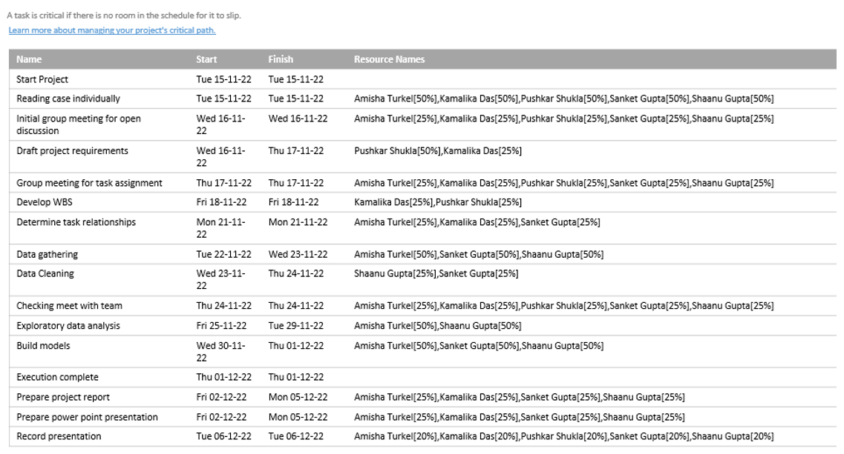
Notes:
After assigning the roles we creates the WBS, assigned the duration for each task

Slide 7
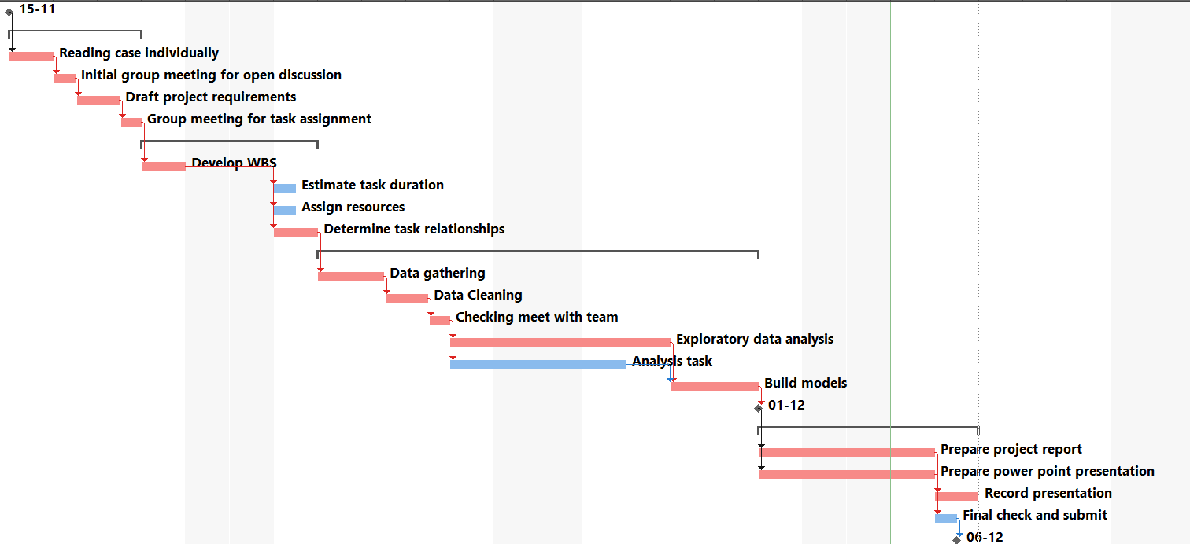
Gantt Chart View

Slide 8

Summary of Plan based approach
PROJECT DURATION
COST
1
16 days
Start date- 15 Nov 2022
End date- 6 Dec 2022
2
Total-$9806
BCWS same as EAC as no additional cost or delay incurred
LEAD TIME
BASELINE
Schedule
Cost
Scope
Resources
CONCLUSION
3
Activities: Prepare report and presentation were brought forward by 10%
4
5
Critical tasks identified
Project completion in time

Slide 9
Project Structure: Agile-based approach
1
BACKLOGS
3
RESOLVED
5
All requirements are listed and alloted for sprints
Required feature of the card delivered
CLOSED
PROBLEM
2
4
IN PROGRESS
Based on acceptance criteria and definition of done, the task is deemed finished
Identify all features required by the Product owner
SME takes up the user story and start working

Slide 10
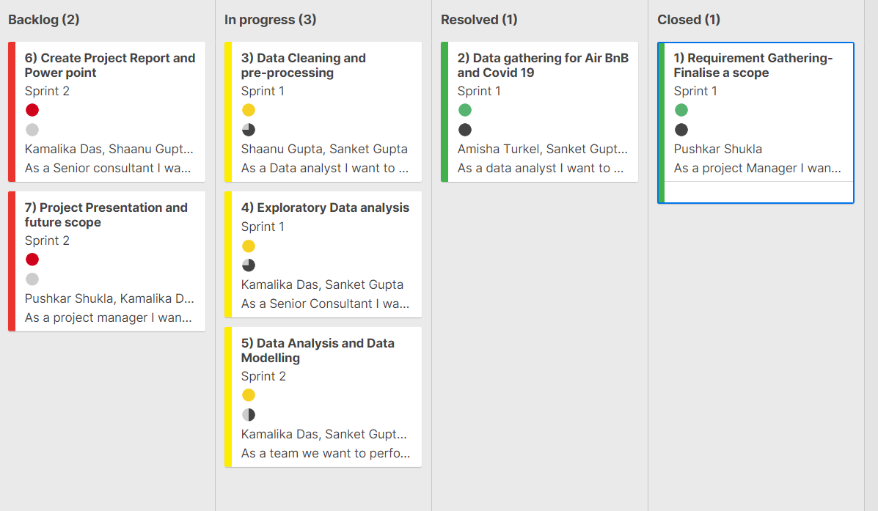
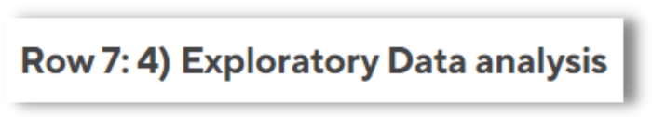
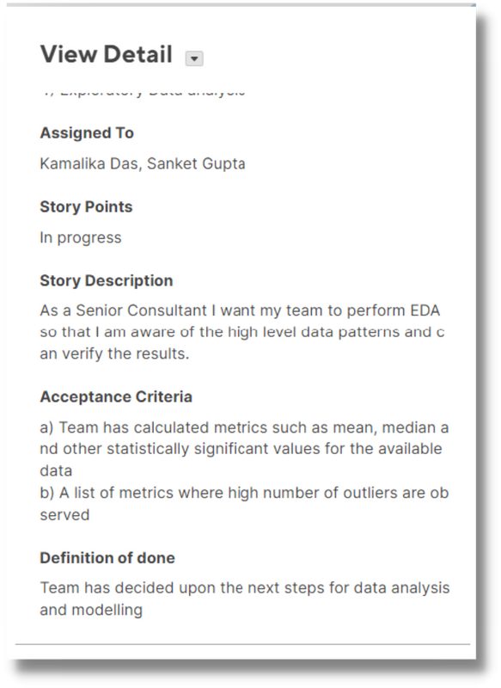
Kanban Board: Set up

Slide 11
Descriptive Analysis of datasets
ACTIVE LISTINGS
Analyze YoY change and
performance against
year of last review
TYPES OF LISTING
Analyze changing customer
due to pandemic on their
stay preferences
REVIEWS
Reviews at a monthly and yearly
level as a proxy to determine
change in pre and post pandemic
1
2
3
PRICE DISTRIBUTION
Changing preference driving
the price change in
accomodation
ACCOMMODATION TYPE BY NEIGHBOURHOOD
%age share of accommodation type YoY change
4
5

Slide 12
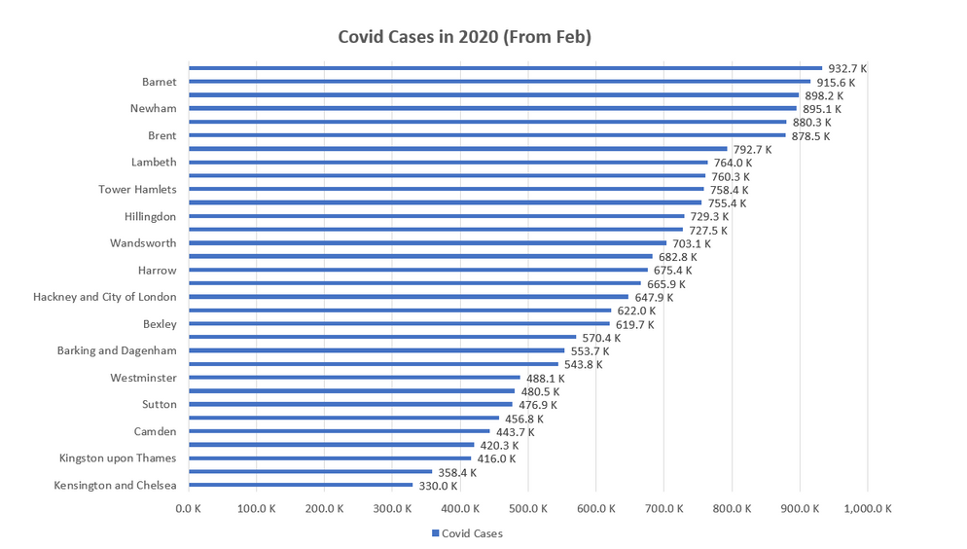
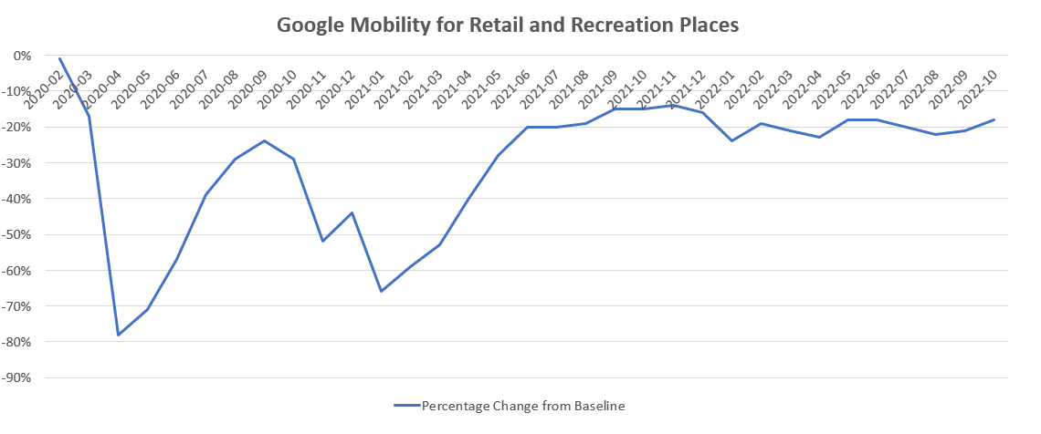
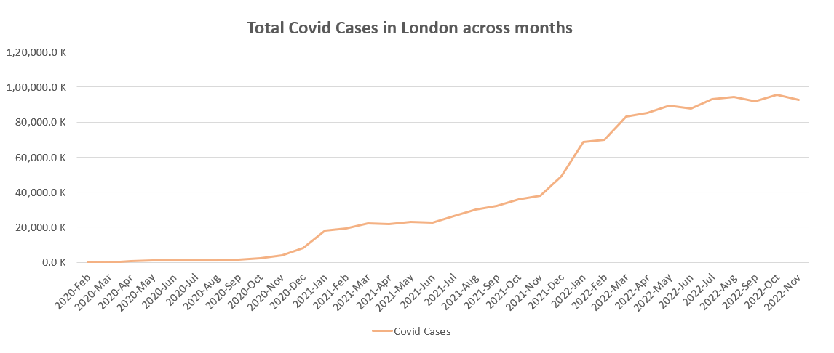
London City Covid Scenario

Slide 13
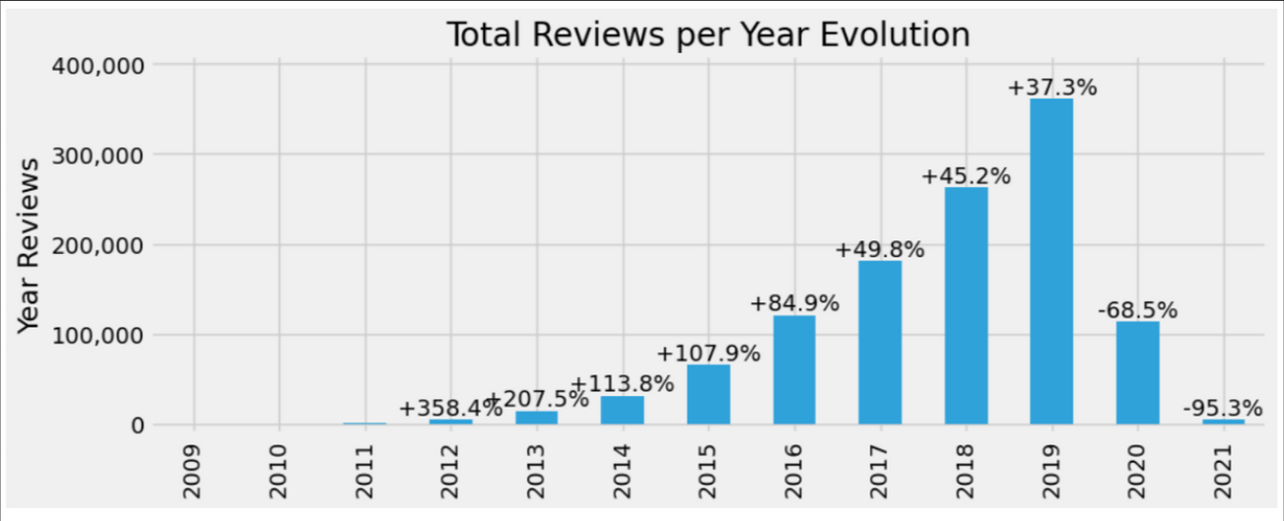
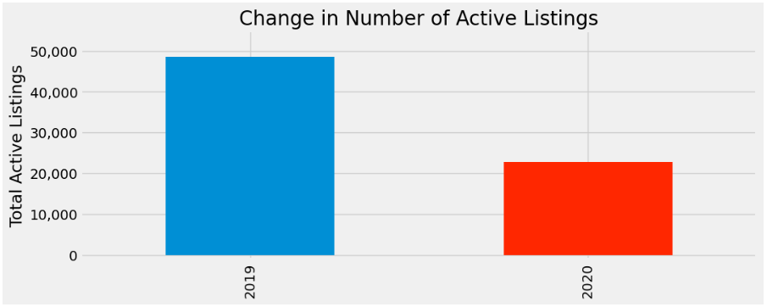
London City Descriptive Analysis
Reviews used as proxy for bookings
Reviews reduced from 2019 to 2020
Active listings reduced by approx 50%
Less foot-falls inturn is indicative of lesser occupancy.
Less supply due to fallen demand because of travel restrictions.

Slide 14
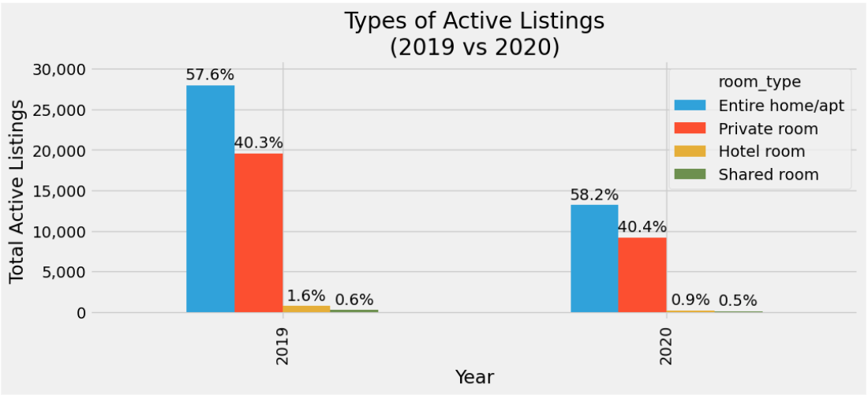
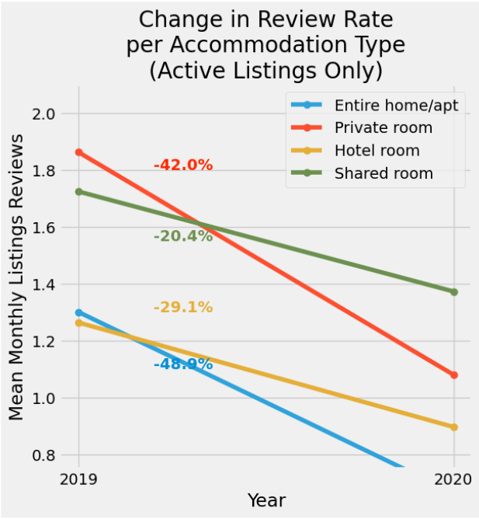
London City EDA
Every type of accommodation sees a fall in total count of active listings
Count of listing for private room reduce substantially hence the review rate for private rooms see a steeper drop.
Similar pattern seen in Entire home/apartment type.

Slide 15
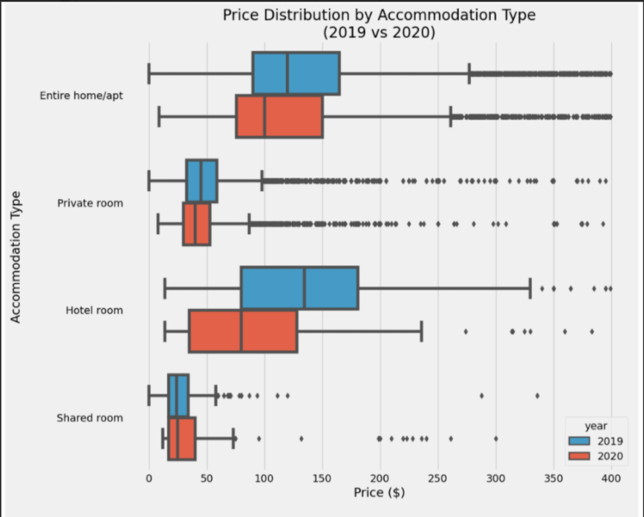
London City EDA
The price marked for all accomodation type were reduced.
The reduction of price in hotel rooms are a lot more drastic as the operational cost of hotels are more. They would have to lower the prices to balance demand and supply.

Slide 16
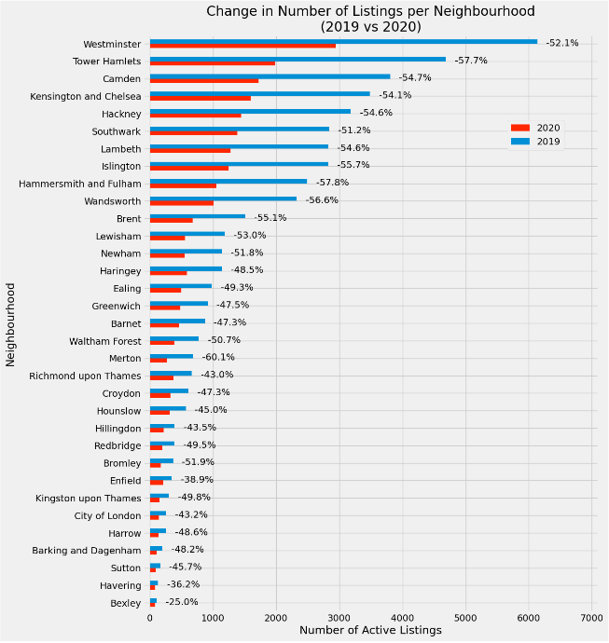
London City EDA
Westminster is more densly populated in than Brent and Bexley hence more probability of covid spread. Thus lesser demand and more reduction in listing.
However Merton sees a higher drop which can be explained due to its proximity to airports

Slide 17
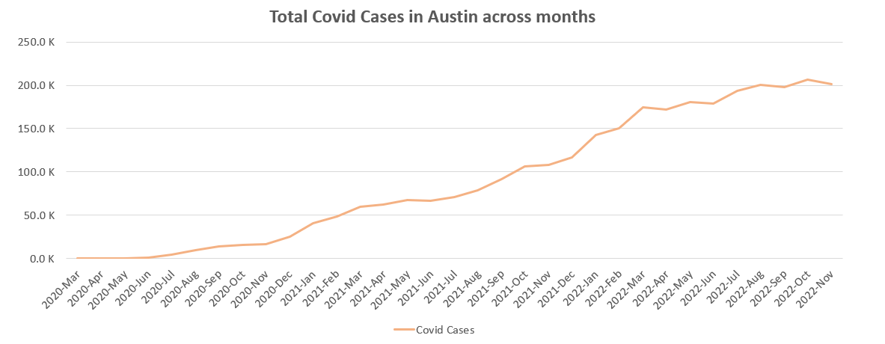
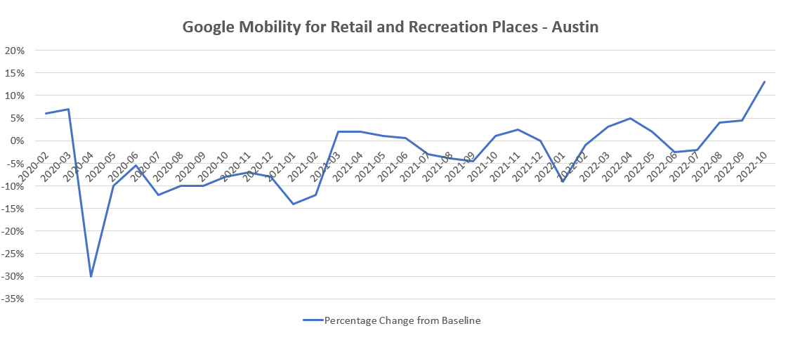
Austin City Covid Scenario

Slide 18
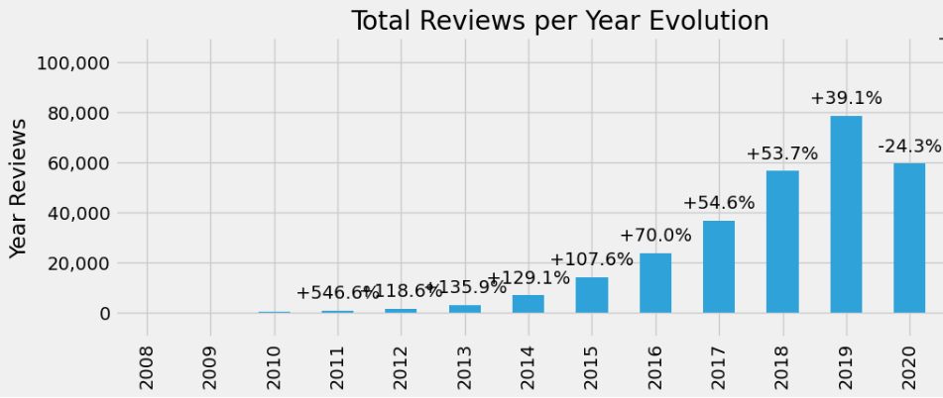
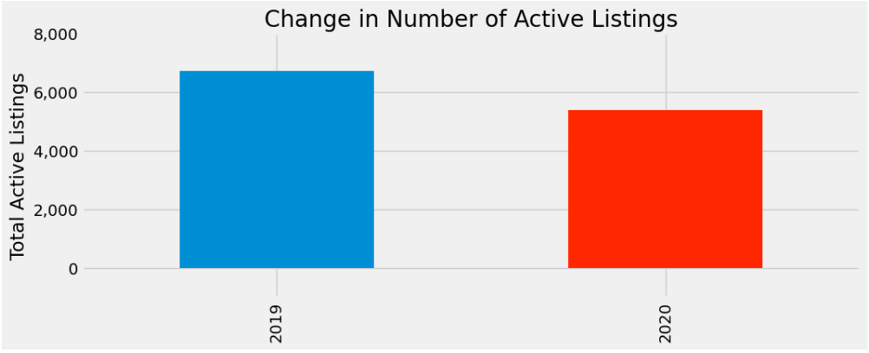
Austin City Descriptive Analysis
Reviews dropped from 2019 to 2020 however the drop is not as drastic as London.
Austin had lesser restrictions placed in comparison hence lesser reduction in listings as well.

Slide 19
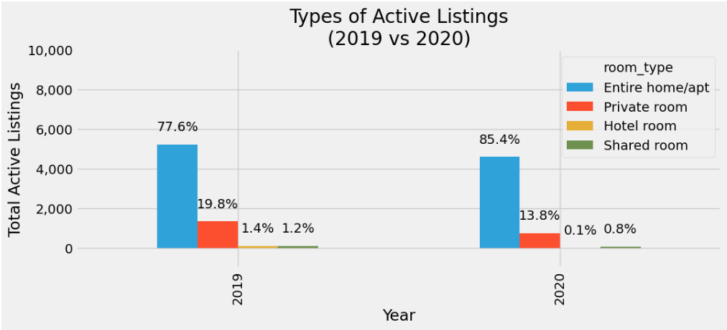
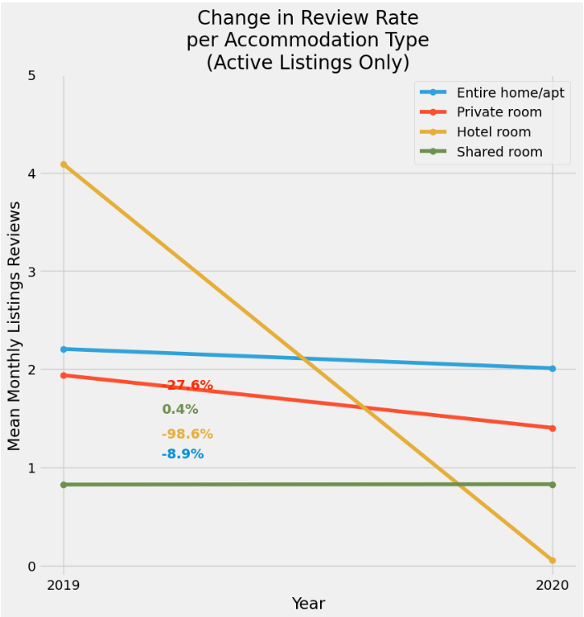
Austin City EDA
Share of Entire Home increased in 2020 in comparison to 2019 in account of covid
All accomodation types other than hotels saw nearly unchanged review rate.
However hotels saw a drastic drop in review rate as a next silicon valley city and remote work-culture in pandemic.

Slide 20
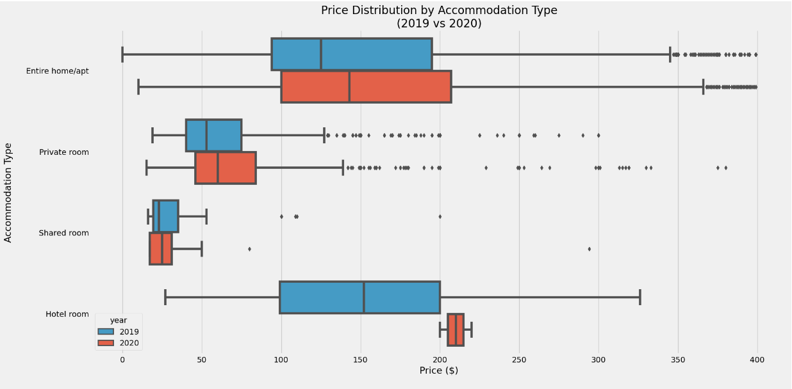
Austin City EDA
The prices of all accomodation type increased in contrast to London as demand for rental housing far outweighs the inventory

Slide 21
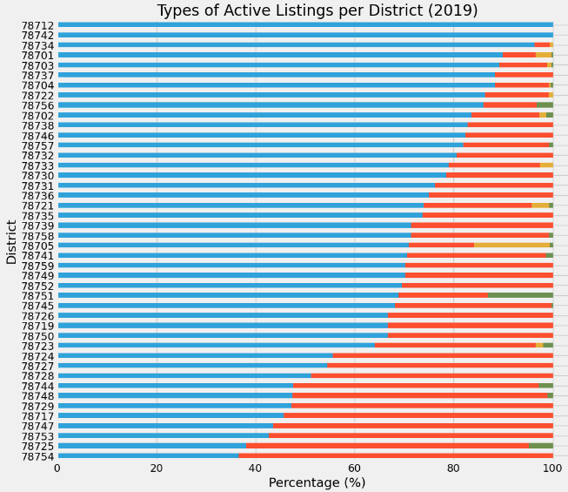
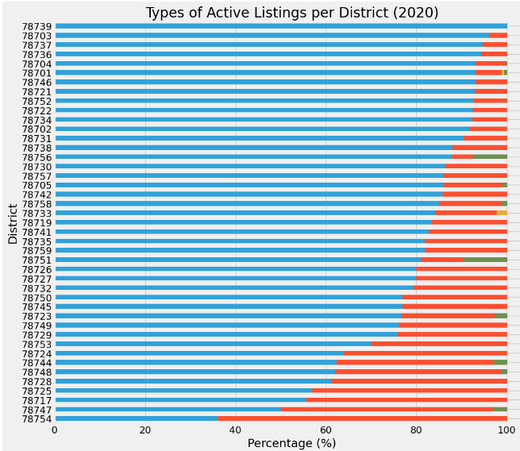
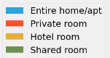
Austin City EDA
At district level, we see share of entire house/apartment increase in the pandemic year.

Slide 22
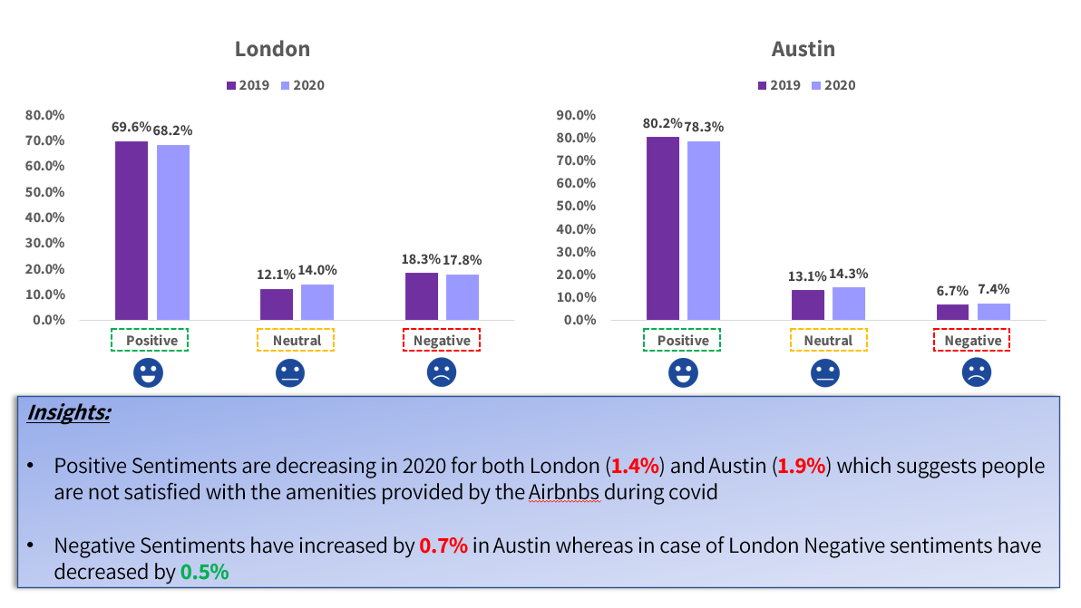
Sentiment Analysis:

Slide 23
Summary
 | London | Austin
Review Frequency Trends | 65% in 2020. | returned to pre-pandemic levels by August and increased Y-on-Y in 2021 to rise above 2019 review levels
Listing Trends | fell from around 60000 to just above 20000. This is a fall of around 66% in supply and is being assumed to match the fall in demand | above 6000 in 2019 to around 200 in 2020. This fall in supply to barely 5% of pre-pandemic levels is still being assumed to have sustained pre-covid demand levels from August 2020 onwards
Customer Demand Preferences | also for Hotelrooms(around 40%), while Private and Shared Rooms registered lower percentage falls(around 28%) | for Hotel Rooms, by almost 100%,while those for Entire Homes and Shared rooms were nearly unchanged. Private room review rates fell by 28%
Inventory Mix | The inventory mix for London was nearly unchanged year-on-year | The relative supply of Entire Homes had gone up in Austin in comparison to a decline in market share of other product categories

Slide 24
Future Recommendations
ENHANCEMENT | DESCRIPTION
Bookings Data | We would like to access actual bookings data to examine changes in other aspects of customer decision-making such as changes in duration of bookings for certain listings or more spontaneous intra-city bookings or for eg, preference for listings that had a greater variety of kitchen appliances
Customer Demand Curve Changes | We would like to examine changes in demand for different pricing and product categories to quantitavely understand changes in customer preferences i.e. whether due to absence of many services, customers would enhance their budgets for AirBnb rentals in certain product categories
AirBnb vs Overall Hospitality Industry | We would like to compare AirBnb Occupancy rates and Revenue performance with other competitors in the Hotel & Lodging Industry
Covid Cases Graph Leading and Lagging Indicators | We would like to examine data for 2021 and see if statistically significant inferences can be drawn for AirBnb Bookings as leading indicator of rise in Covid cases
Supply-Side Changes | We would like to examine the impact of covid on supply-side changes as well i.e. a change in price for different product types as well as availability for eg. with owners unable to move to summer homes or on vacations themselves, they would have been unable to rent their own homes out.

Slide 25
Thank you
Questions

